Slide 1
Foundations of Inclusive Education
Simulation Activities

Slide 2
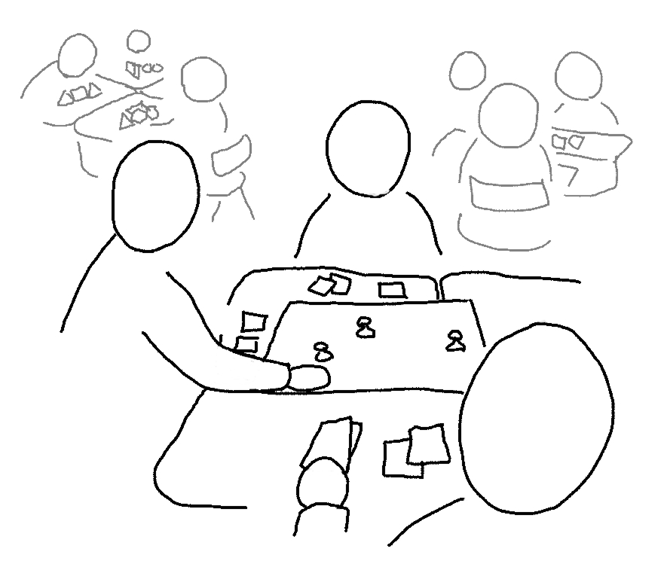

Learning Stations
Work in small groups & follow directions at the station.
Rotate between stations when given signal.
Each station gives a brief experience with a particular disability.
Pay attention to your thoughts and feelings.

Slide 3

Reflective Writing
After each station experience complete “Reflective Writing Questions”.
Move to next station with signal.

Slide 4

Issues
What is the relationship between simulation activities and the purpose of (dis)ability awareness activities?
How does this approach fit in, or not, with the current social justice / human rights paradigm on disability?

Slide 5

Video

